Slide 1



AWS Development
M.Udayakumar
Cloud Solution Architect

Slide 2
Outline
Introduction to Cloud Computing
AWS S3
AWS EC2
EC2 API
A Case Analysis on using AWS
Future Directions

Slide 3
Cloud Computing
Cloud computing is the on-demand delivery of compute power, database storage, applications, and other IT resources through a cloud services platform via the Internet with pay-as-you-go pricing.
Cloud computing provides a simple way to access servers, storage, databases and a broad set of application services over the Internet.
A cloud services platform such as Amazon Web Services owns and maintains the network-connected hardware required for these application services, while you provision and use what you need via a web application.

Slide 4
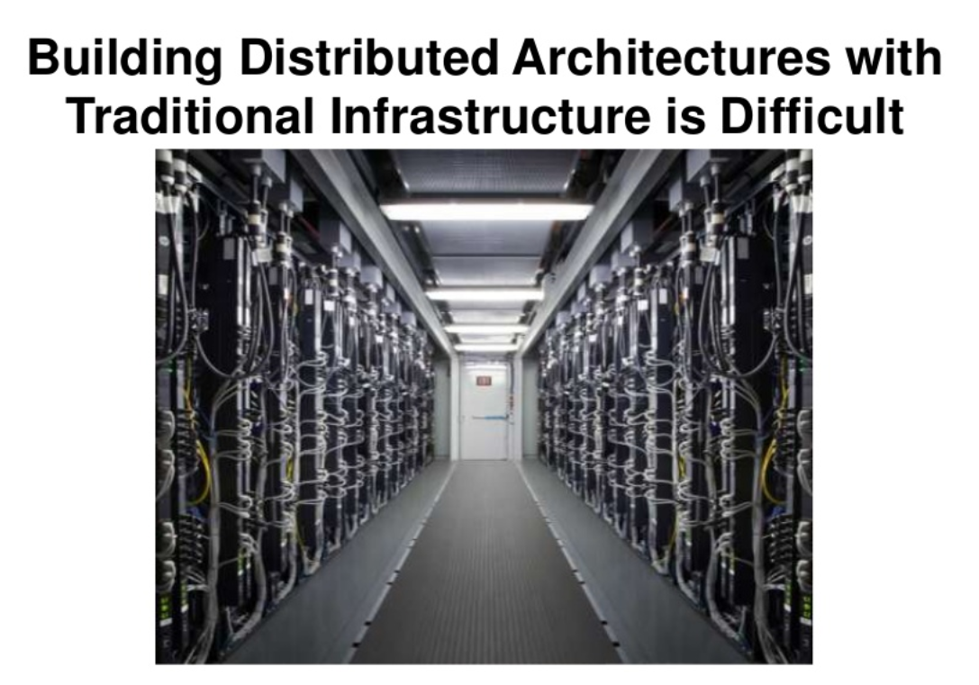
Cloud Computing

Slide 5
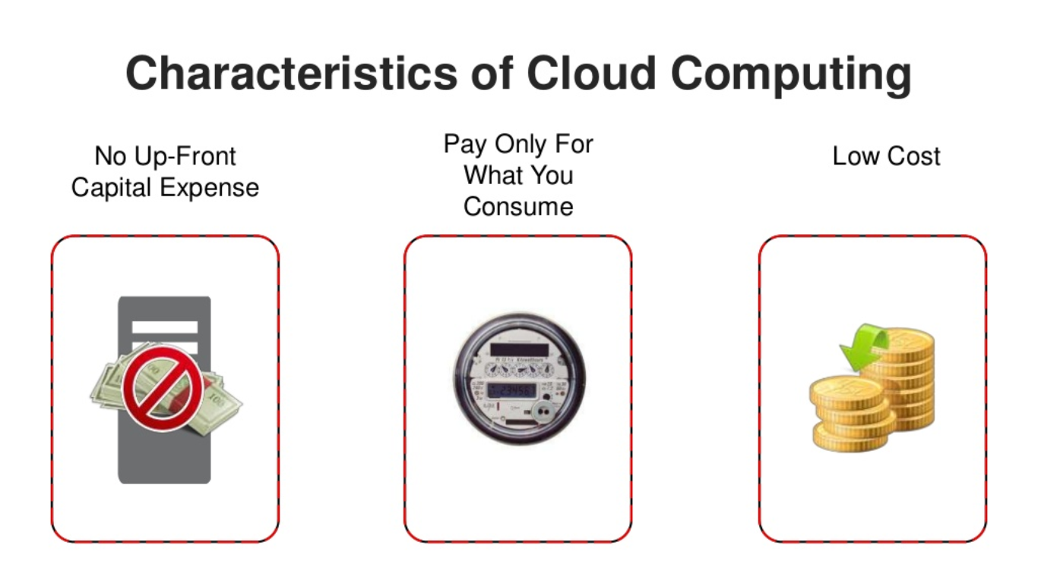
Cloud Computing

Slide 6
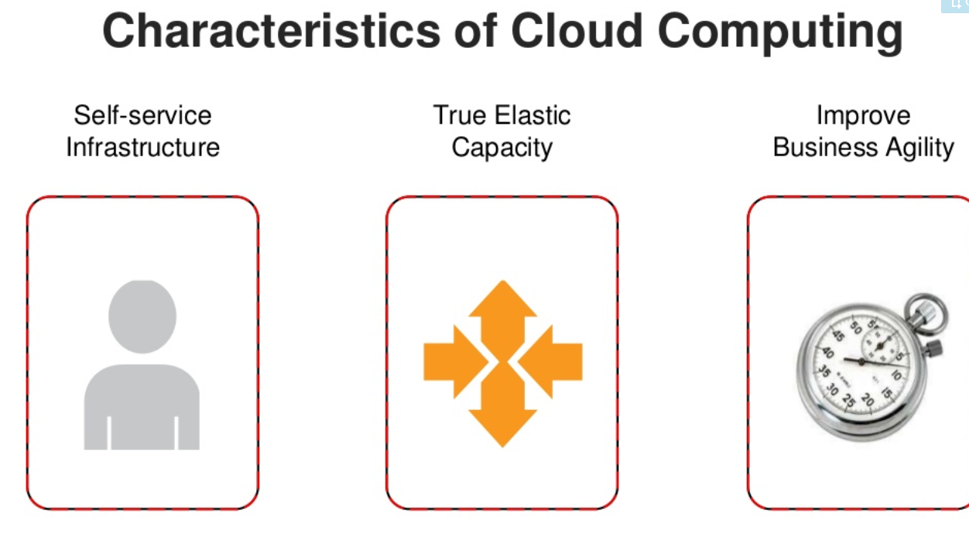
Cloud Computing

Slide 7
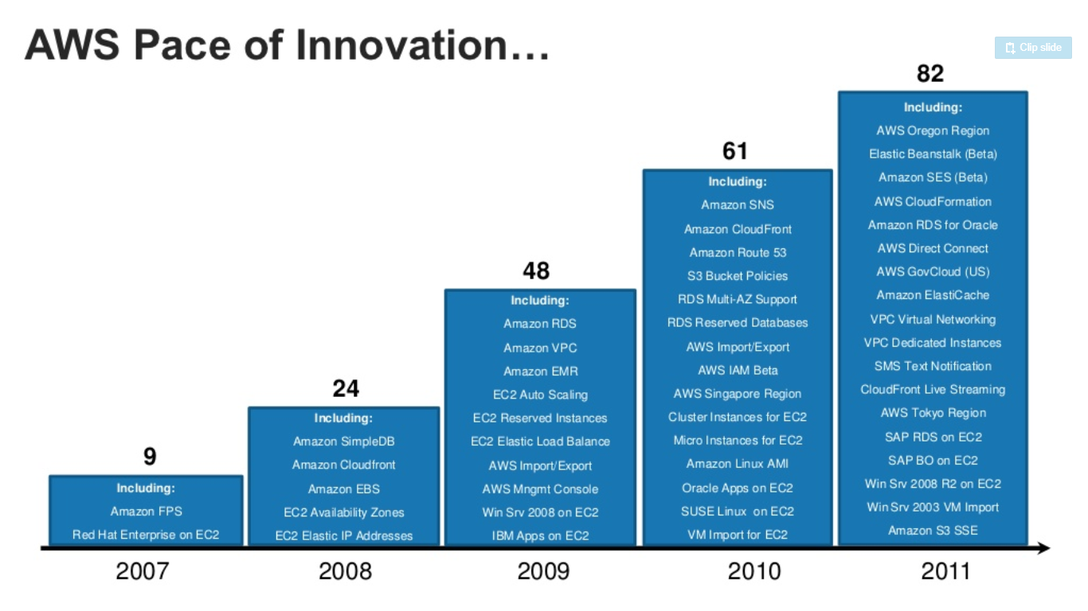
Cloud Computing

Slide 8
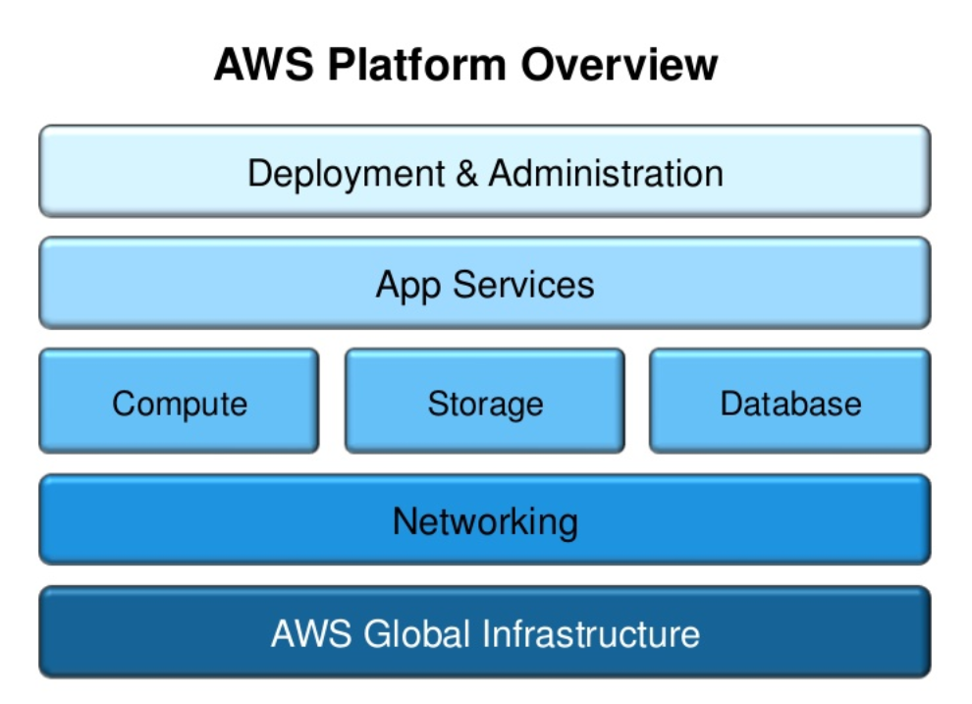
Cloud Computing

Slide 9
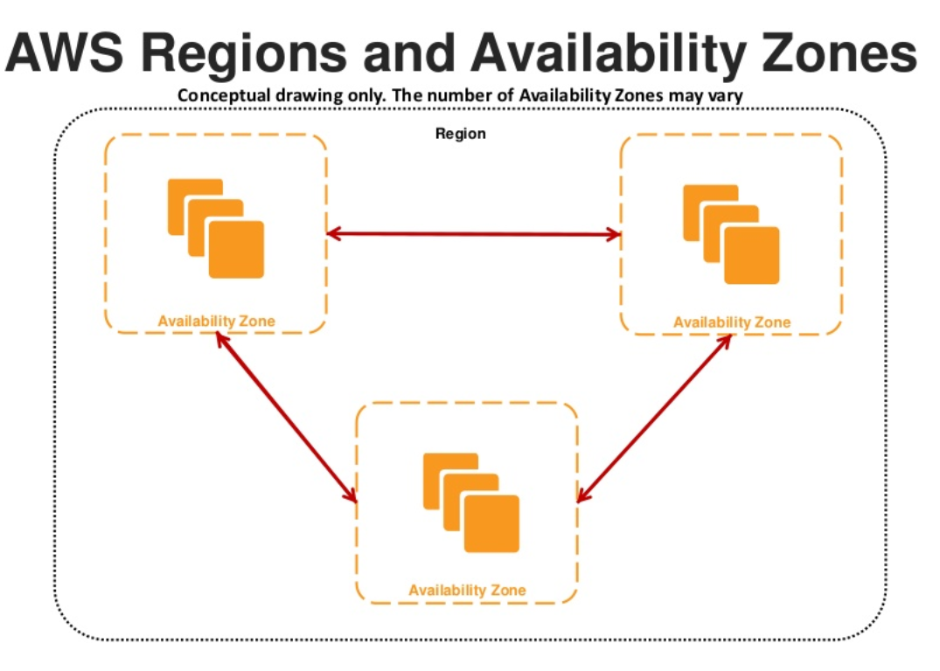
Cloud Computing

Slide 10
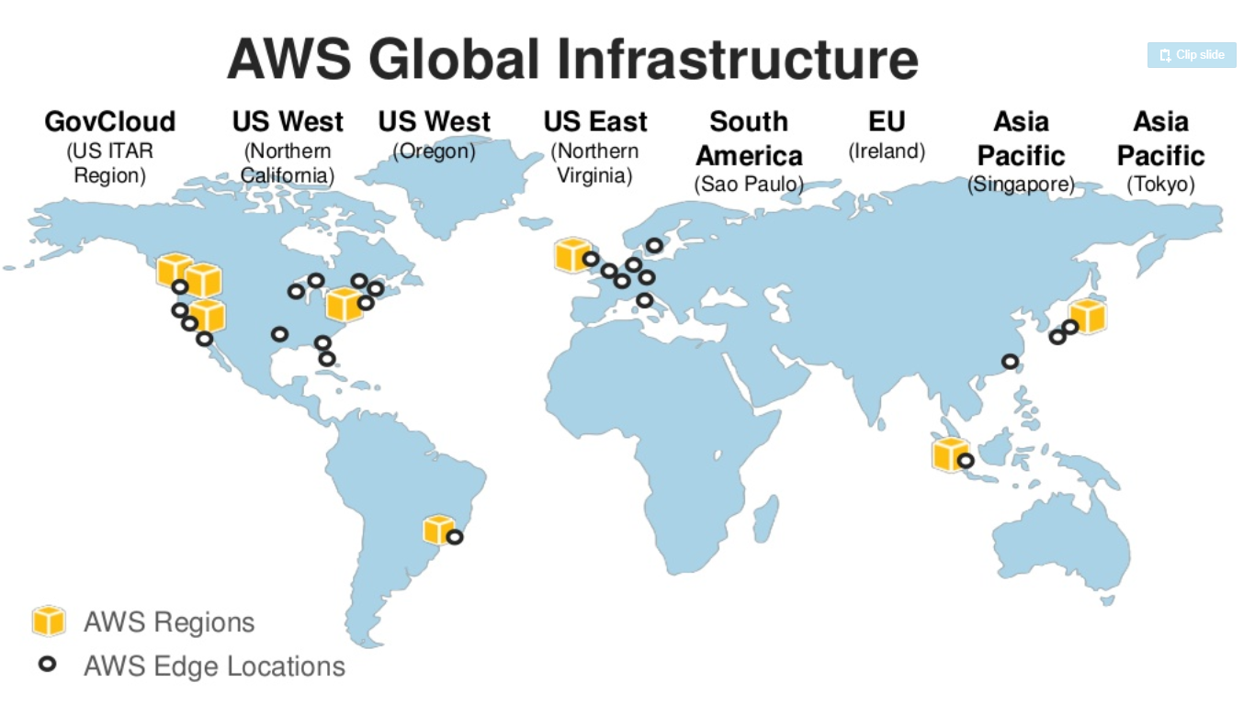
Cloud Computing

Slide 11
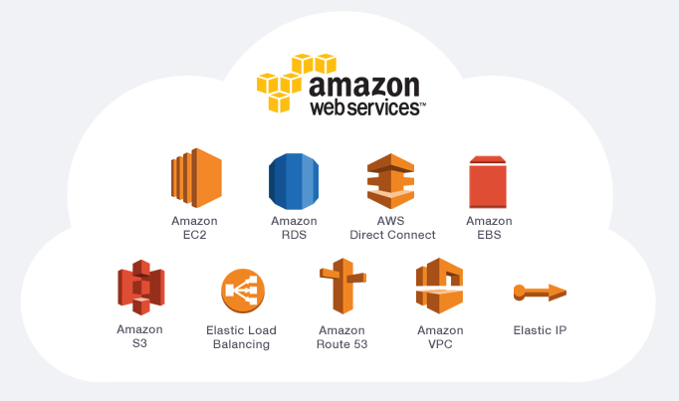
AWS SERVICES

Slide 12
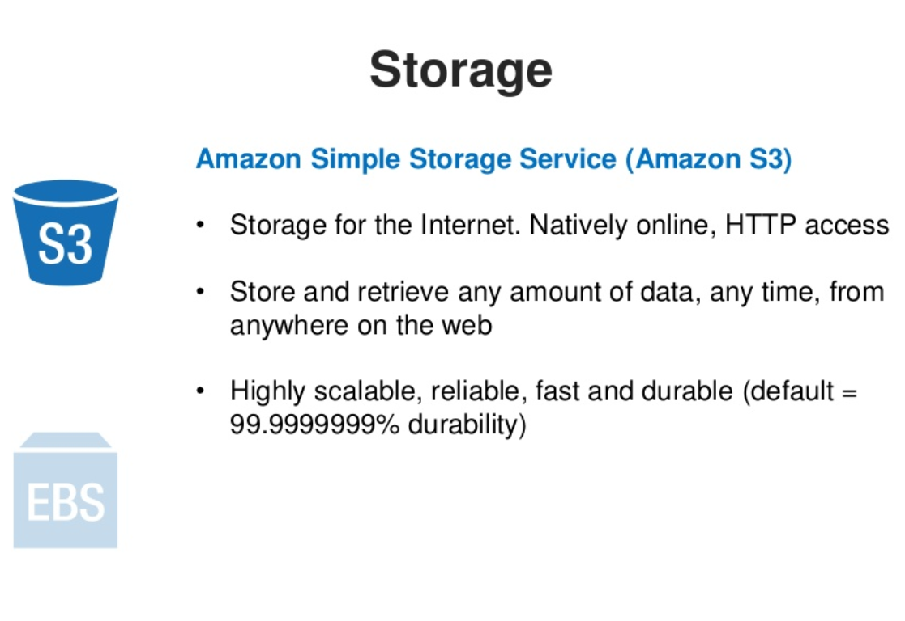
Cloud Computing

Slide 13
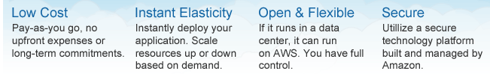
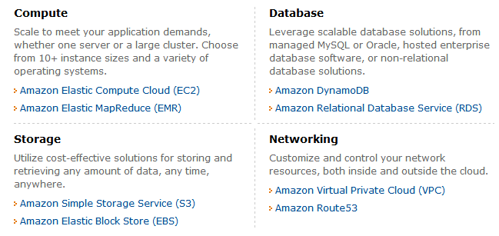

Slide 14
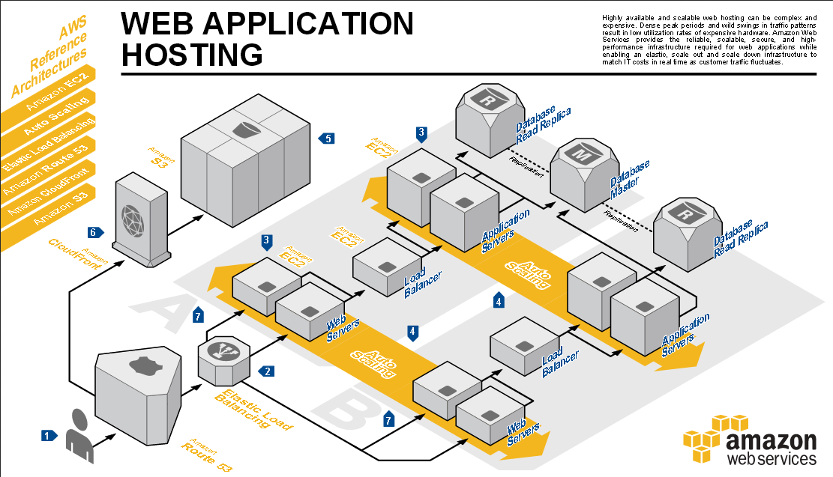
Example Application Hosting in AWS

Slide 15
Lab Steps
Amazon Web Services
AWS Architecture
Add AWS Education Credit for $100
AWS Account Creation
SSH to instance
Launch instance
Lab – AWS Account Setup, Services Overview, Resource Discovery, and Instance Setup
Purpose of the Lab
Understand definitions of various Amazon Web Services (AWS) and their use in cloud computing based web applications that are accessible over the Internet through an AWS account
Use the AWS account for the discovery, reservation and access of virtual compute/storage infrastructure instances

Slide 16
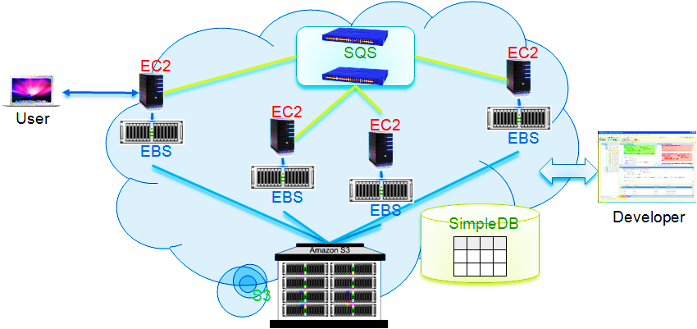
AWS Platform Example Deployment

Slide 17
AWS Execution Environment
Private AMI: Images created by you, which are private by default; you can grant access to other users to launch your private images
Public AMI: Images created by users and released to the community, so anyone can launch instances based on them and use them any way they like
Paid AMI: You can create images providing specific functions that can be launched by anyone willing to pay you per each hour of usage on top of AWS charges

Slide 18
Cost Saving Considerations in AWS
On-Demand Instances
Pay for compute capacity by the hour with no long-term commitments
Reserved Instances
Make a low, one-time payment for each instance you want to reserve and in turn receive a significant discount on the hourly charge for that instance
Spot Instances
Bid on unused EC2 capacity and run those instances for as long as their bid exceeds the current Spot Price

Slide 19
Amazon EC2 Functionality
Select a pre-configured, templated image to get up and running immediately. Or create an Amazon Machine Image (AMI) containing your applications, libraries, data, and associated configuration settings.
Configure security and network access on your Amazon EC2 instance.
Choose which instance type(s) and operating system you want, then start, terminate, and monitor as many instances of your AMI as needed, using the web service APIs or the variety of management tools provided.
Determine whether you want to run in multiple locations, utilize static IP endpoints, or attach persistent block storage to your instances.
Pay only for the resources that you actually consume, like instance-hours or data transfer.

Slide 20
Instance Types
Standard Instances:
Small: 1.7GBmem, 1EC2Compute Unit (EC2CU), 160GB local instance storage(lis), 32/64bits.
Medium: 3.75 GBmem, 2EC2CU, 410GBlis, 32/64bits.
Large: 7.5GBmem, 4EC2CU, 850GBlis, 64bits
Extra Large: 15GBmem, 8EC2CU, 1690GBlis, 64bits.
Micro Instances: 613MBmem, 2ECUs, EBS
High-Memory Instances: 17.1, 34.2, 68.4GBs.
High-CPU Instances (5EC2CU or 20EC2CU)
Cluster GPU Instances (22GBmem, 33.5EC2CU, 2xNVIDIA Tesla “Fermi” M2050 GPUs, 1690GBlis, 10GEthernet.

Slide 21
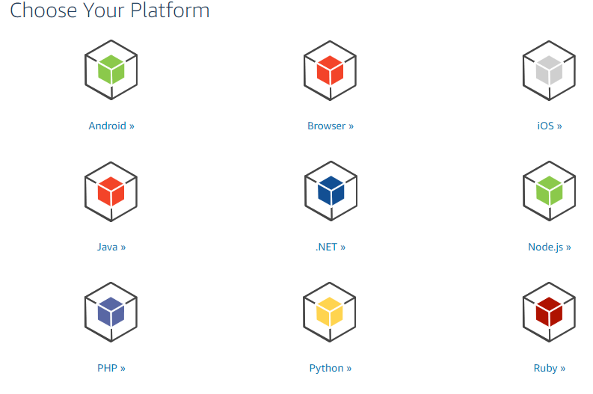
AWS Development

Slide 22
AWS Development
AWS SDK
AWS Toolkit

Slide 23
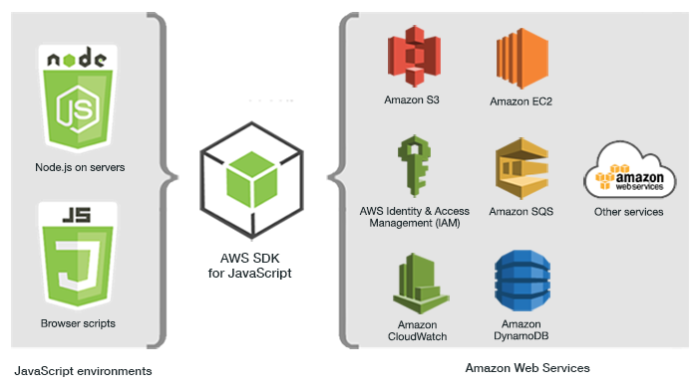
AWS SDK for Javascript

Slide 24
AWS SDK for Javascript
Using the SDK with Node.js
Node.js is a cross-platform runtime for running server-side JavaScript applications. You can set up Node.js on an Amazon EC2 instance to run on a server. You can also use Node.js to write on-demand AWS Lambda functions.
Using the SDK with AWS Cloud9
You can also develop Node.js applications using the SDK for JavaScript in the AWS Cloud9 IDE

Slide 25
AWS SDK for Javascript
Using the SDK with Node.js
Node.js is a cross-platform runtime for running server-side JavaScript applications. You can set up Node.js on an Amazon EC2 instance to run on a server. You can also use Node.js to write on-demand AWS Lambda functions.
Using the SDK with AWS Cloud9
You can also develop Node.js applications using the SDK for JavaScript in the AWS Cloud9 IDE

Slide 26
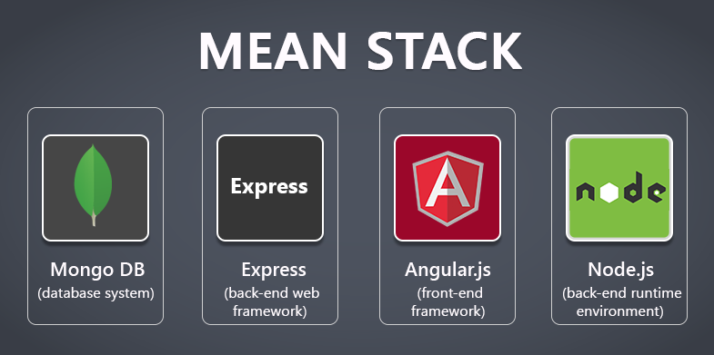
NodeJS and MEAN
cs6320

Slide 27
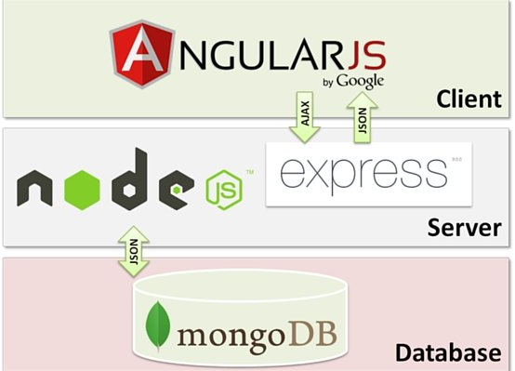
First what is MEAN
M = mongoDB
E = Express
A = Angular.js
N=Node.js
FULL stack solution

Slide 28
What is node.js ?
Created 2009
Evented I/O for JavaScript
Server Side JavaScript
Runs on Google's V8 JavaScript Engine

Slide 29
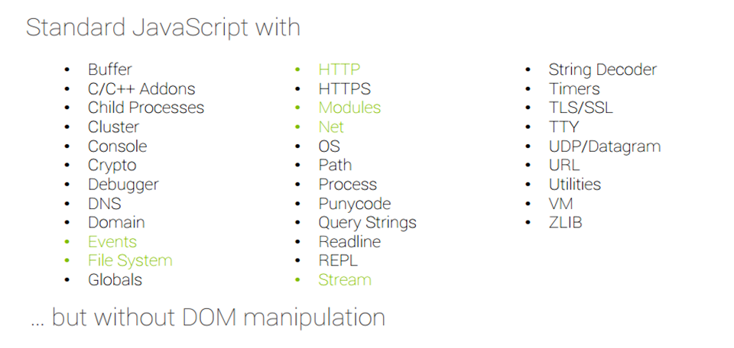
Why Use Node.js ?
Node's goal is to provide an easy way to build scalable network programs.

Slide 30
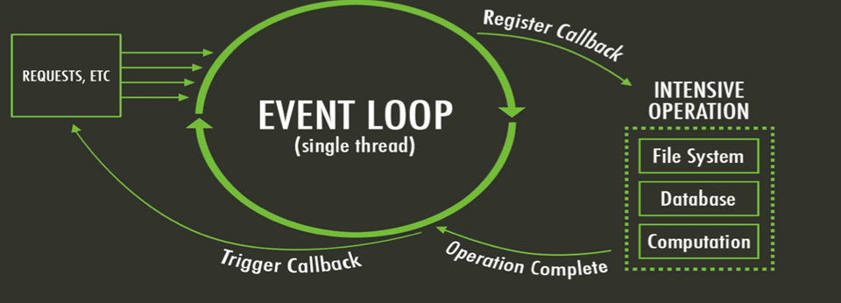
What is unique about Node.js?
JavaScript on server-side thus making communication between client and server will happen in same language
Servers normally thread based but Node.JS is “Event” based. Node.JS serves each request in a Evented loop that can handle simultaneous requests.
Notes:
Thread based servers like Apache server will serve each web request as individual threads which doesn’t fit well for concurrent connections.

Slide 31
What can you do with Node ?
It lets you Layered on top of the TCP library is a HTTP and HTTPS client/server.
The JS executed by the V8 javascript engine (the thing that makes Google Chrome so fast)
Node provides a JavaScript API to access the network and file system.

Slide 32
What can’t do with Node?
Node is a platform for writing JavaScript applications outside web browsers. This is not the JavaScript we are familiar with in web browsers. There is no DOM built into Node, nor any other browser capability.
Node can’t run on GUI, but run on terminal

Slide 33
Why node.js use event-based?
normal process the webserver while processing the request will have to wait for the IO operations and thus blocking the next request to be processed.
Node.JS process each request as events, doesn’t wait (non-blocking) for the IO operation to complete → it can handle other request at the same time.
When the IO operation of first request is completed it will call-back the server to complete the request.

Slide 34
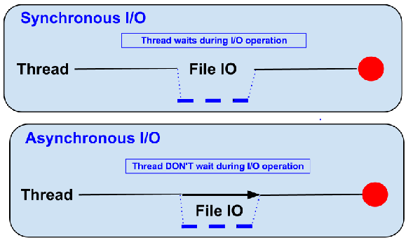
Blocking vs Non-Blocking……
Example :: Read data from file and show data

Slide 35
Node.js VS Apache
It's faster
It can handle tons of concurrent requests
Platform | Number of request per second
PHP ( via Apache) | 3187,27
Static ( via Apache ) | 2966,51
Node.js | 5569,30

Slide 36
Supports HTTP Method……
● GET
● POST
● PUT
● DELETE

Slide 37
File package.json…..
{
"name": "node-js-getting-started",
"version": "0.2.5",
"description": "A sample Node.js app using Express 4",
"engines": {
"node": "5.9.1"
},
"main": "index.js",
"scripts": {
"start": "node index.js"
},
"dependencies": {
"body-parser": "^1.16.1",
"cookie-parser": "^1.4.3",
"cool-ascii-faces": "1.3.4",
"ejs": "2.4.1",
"express": "^4.13.3",
"express-session": "^1.15.1",
"mongodb": "^2.2.24",
"multer": "^1.3.0",
"pg": "4.x",
"pug": "^2.0.0-beta11"
},
"repository": {
"type": "git",
"url": "https://github.com/heroku/node-js-getting-started"
},
"keywords": [
"node",
"heroku",
"express"
],
"license": "MIT"
}
Project information
• Name
• Version
• Dependencies
• Licence
• Main file
Etc...

Slide 38
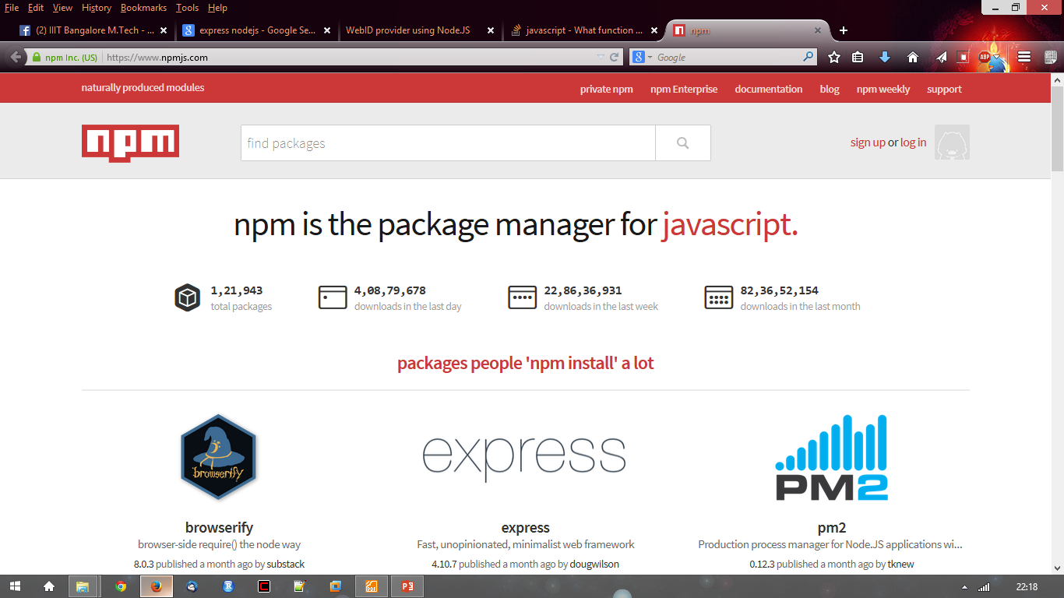
Node.js Modules….. MANY
● https://npmjs.org/
● # of modules = 1,21,943

Slide 39
Install a module…..inside your project directory
$npm install <module name>

Slide 40
Using module….. Inside your javascript code
var http = require(‘http’);
var fs = require(‘fs’);
var express = require(‘express’);

Slide 41
Hello World Example
STEP 1: create directory and call npm install and follow instructions
>mkdir myapp
>cd myapp
Use the npm init command to create a package.json file for your application.
> $ npm init
prompts you for a number of things, such as the name and version of your application. For now, you can simply hit RETURN to accept the defaults

Slide 42
Hello World example
Create file index.js with the following code:
http.createServer(function (request, response) {
// Send the HTTP header
// HTTP Status: 200 : OK
// Content Type: text/plain
response.writeHead(200, {'Content-Type': 'text/plain'});
// Send the response body as "Hello World“
response.end('Hello World\n'); }).listen(8081);
// Console will print the message
console.log('Server running at http://127.0.0.1:8081/');

Slide 43
Hello World example –package.json – describes application
{
"name": "helloworld", "version": "1.0.0", "description": " CGI hello world app", "main": "index.js", "scripts": { "test": "echo \"Error: no test specified\" && exit 1" }, "author": “Udayakumar", "license": "ISC", "dependencies": { "express": "^4.14.1"
}
}

Slide 44
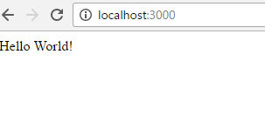
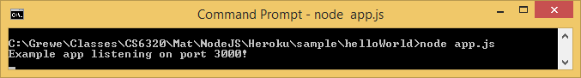
Run your hello world application
Run the app with the following command:
$ node app.js
Then, load http://localhost:3000/ in a browser to see the output.

Slide 45

Architectural style

Slide 46

SOA
service
oriented
architecture
Modernized version of SOA
New world:
Speed of delivery
Scalability
Innovation / experimentation
Cloud / devops

Slide 47
VS
monolith
microservices

Slide 48
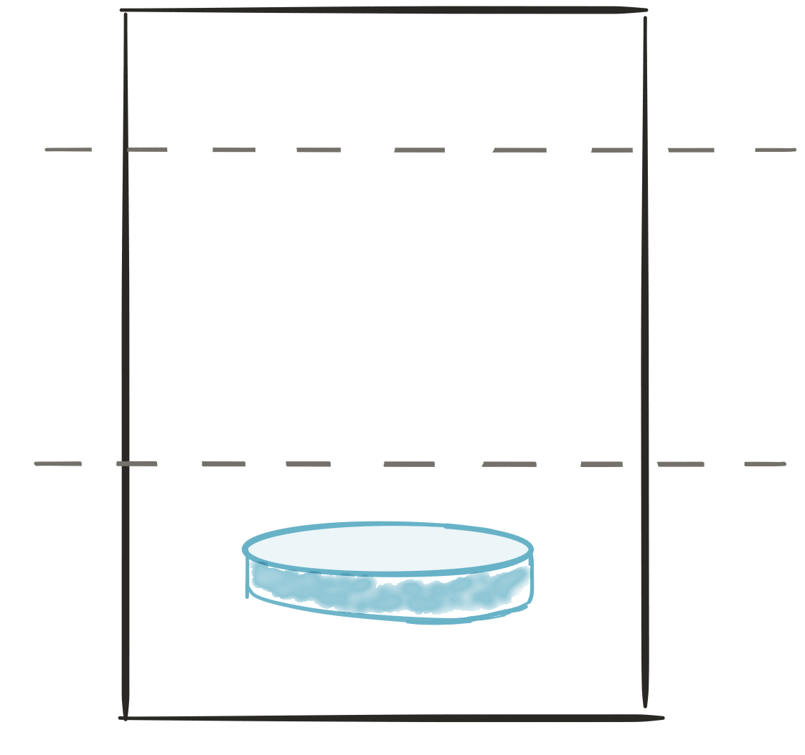
A monolith
Module
A
Module
B
Module
c
Module
D
PRESENTATION LAYER
BUSINESS LOGIC LAYER
DATABASE LAYER

Slide 49
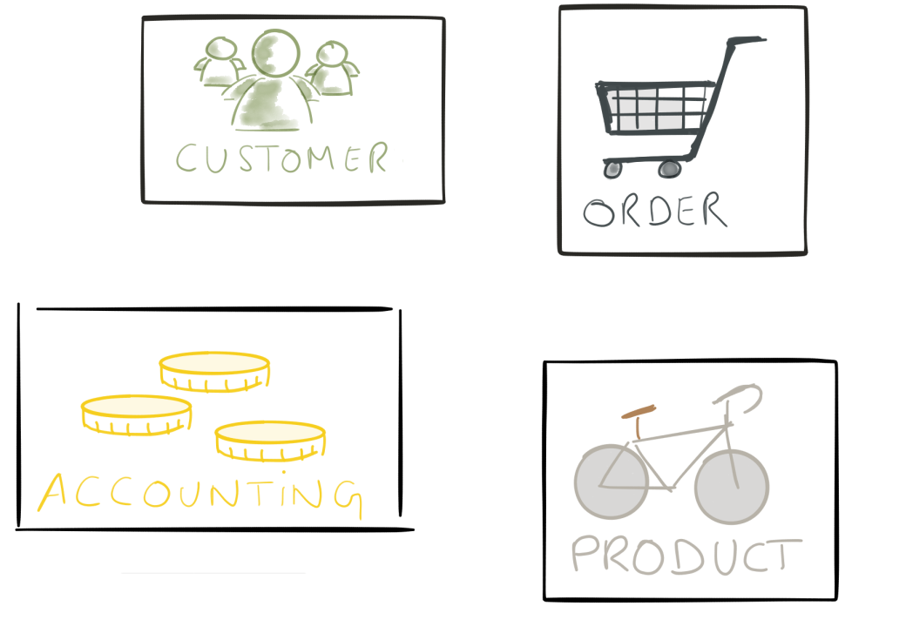
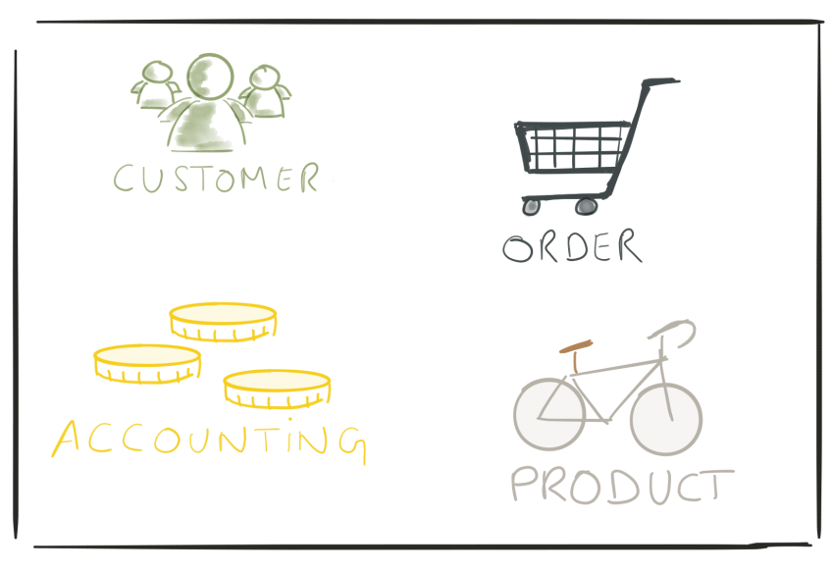
VS
monolith
microservices

Slide 50
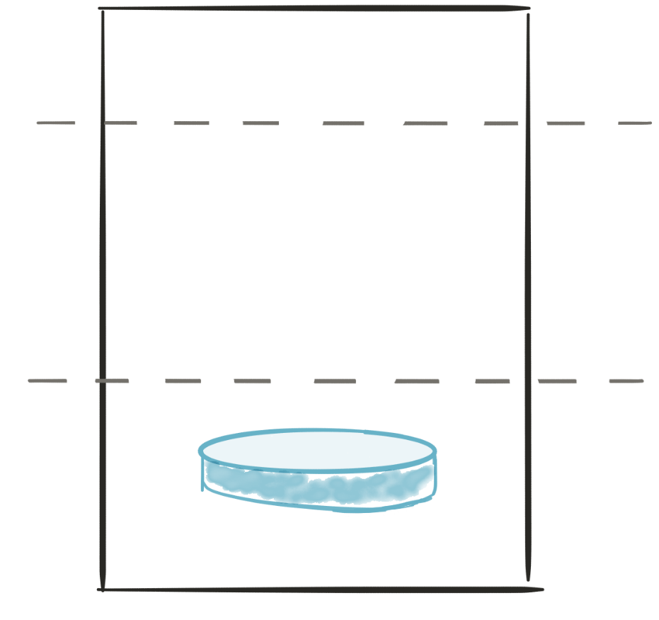

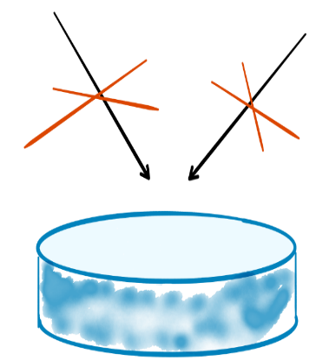
microservices
API
API
PRESENTATION LAYER
consume
Produce
BUSINESS LOGIC
LAYER
BUSINESS LOGIC LAYER
DATABASE LAYER
DATABASE LAYER
Microservice 2
Microservice 1

Slide 51
principles
Modularity
Autonomous
hide implementation details
automation
Stateless
highly observable

Slide 52
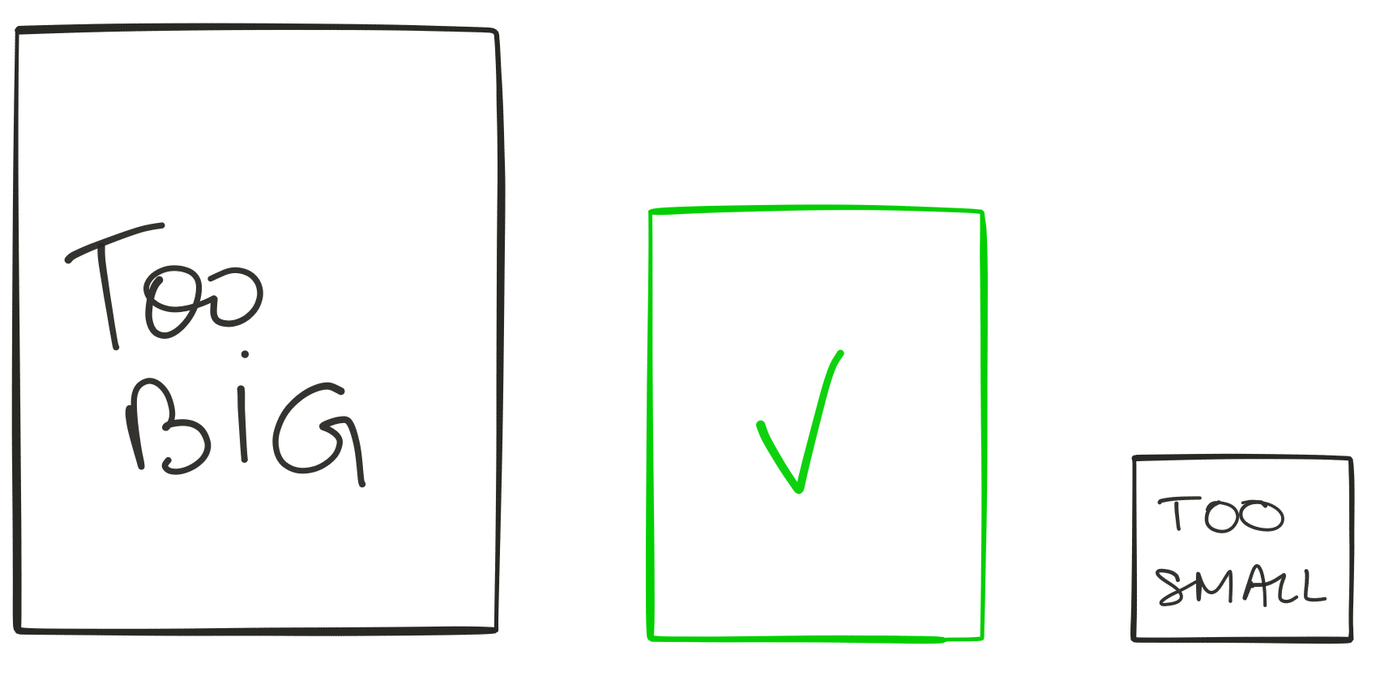
modularity

Slide 53

modularity
ModeLled around business capability
Single responsibility
Single data domain
Separation of concerns
Low coupling
Understandable by a person

Slide 54






Modularity (TEAM)
A product not a project
UI - team
UI
dba
SERVER
SERVER - team
UI
dba
SERVER
Dba - team
UI
dba
SERVER
monolith
microservices

Slide 55




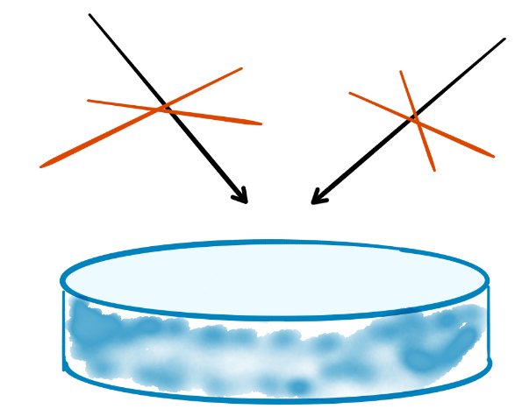
autonomous

Slide 56



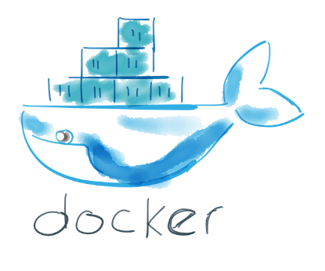

autonomous
- Libraries
- http listener
monolith
microservices

Slide 57
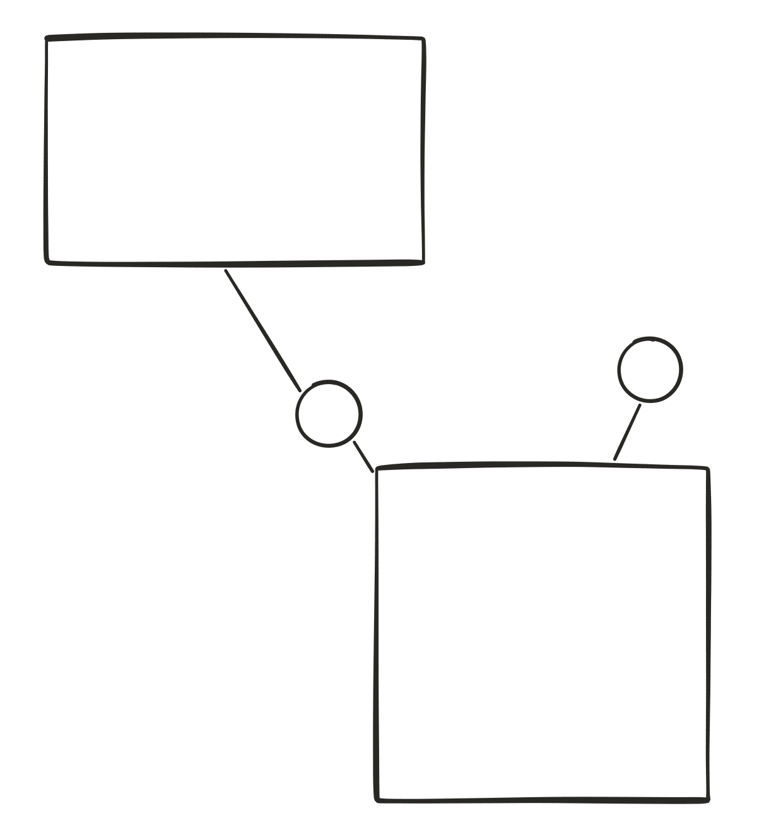

autonomous
v2
v1

Slide 58
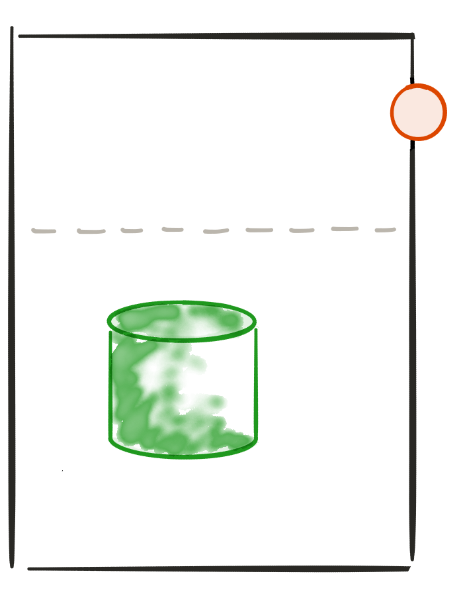
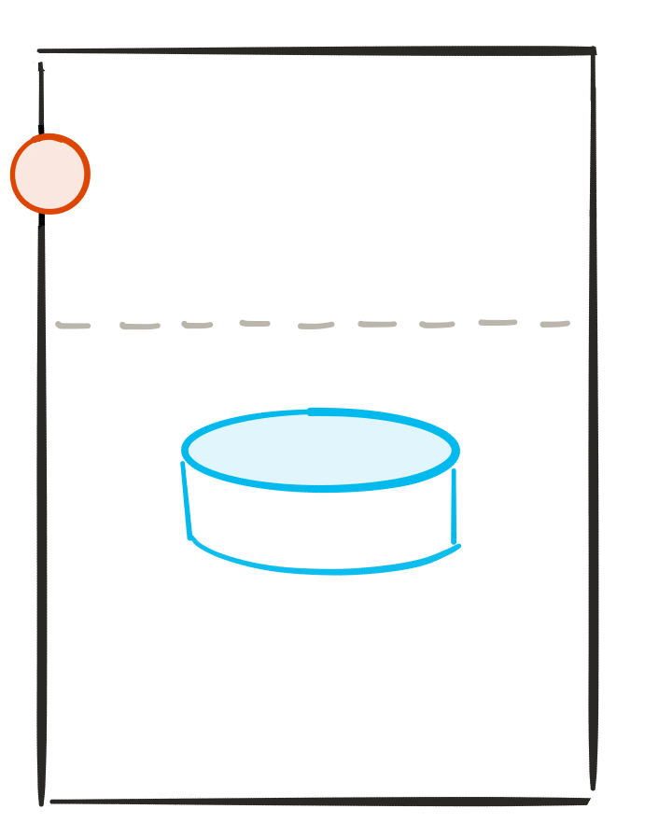






hide implementation details
API
-http
-rest
-json
API
http-
Rest-
Json-

Slide 59




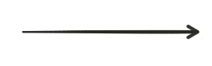
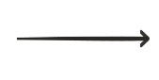
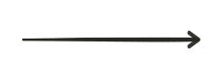
automation
Deploy
On dev/TEST
Deploy on
prod
build
testing
Continuous integration
Continuous deployment

Slide 60
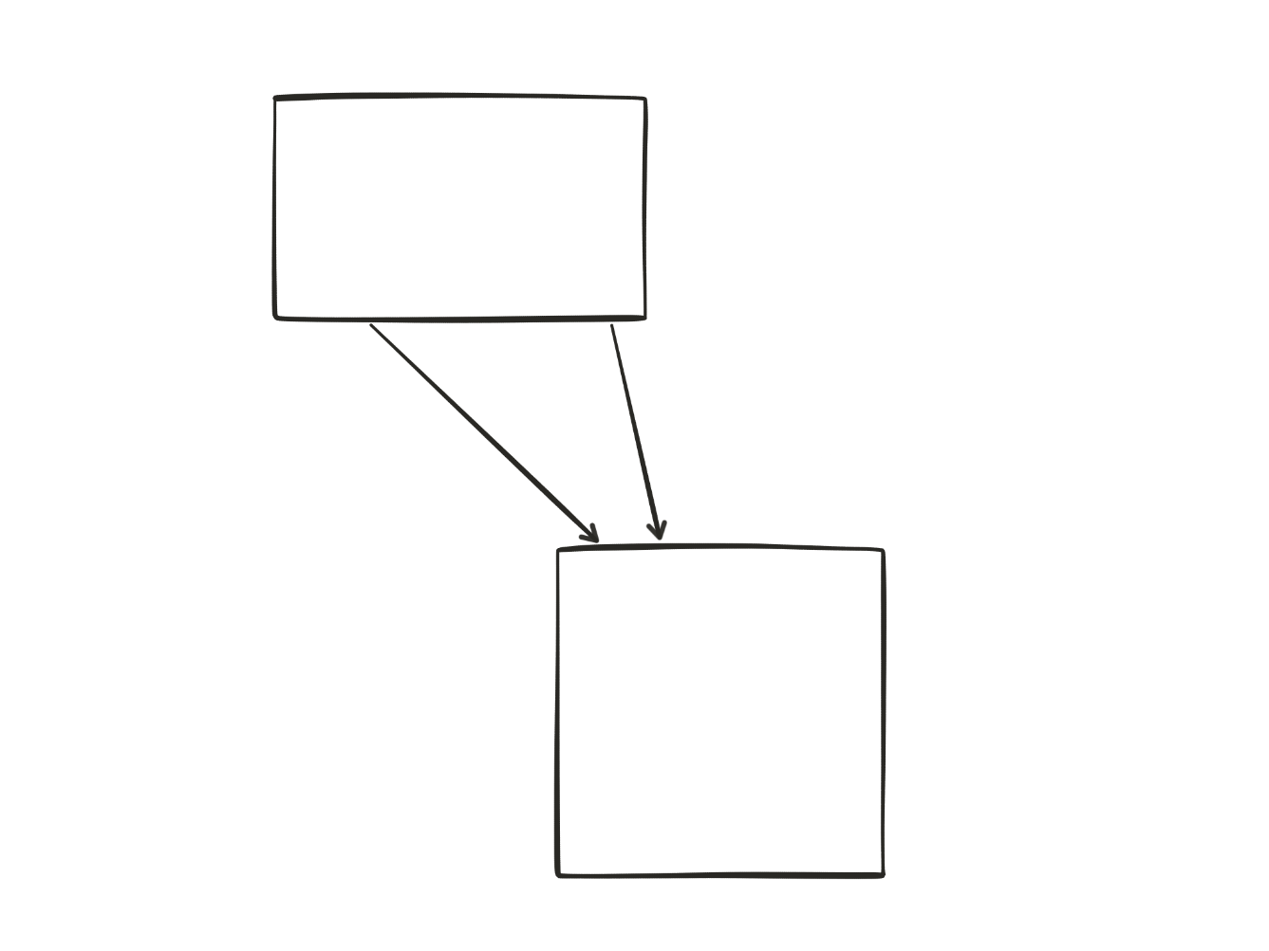
stateless
(2)
(1)
Notes:
Easier to scale / recover from failure

Slide 61

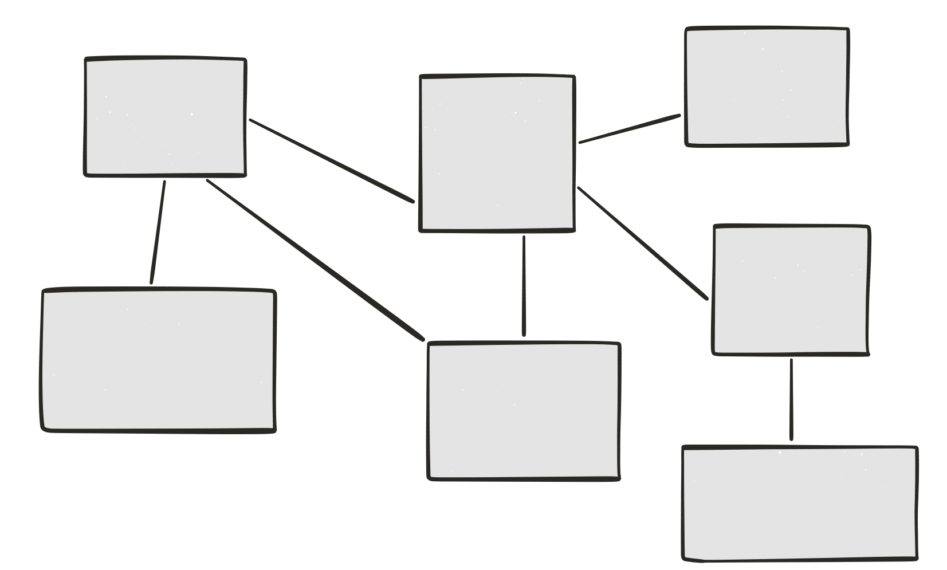
Highly observable
Logs

Slide 62
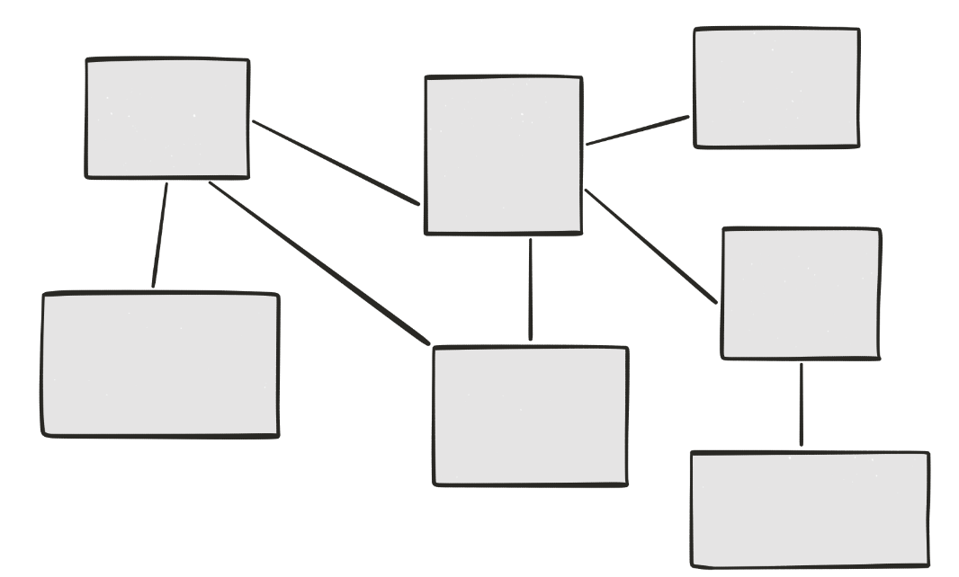

Highly observable
Centralized logging

Slide 63
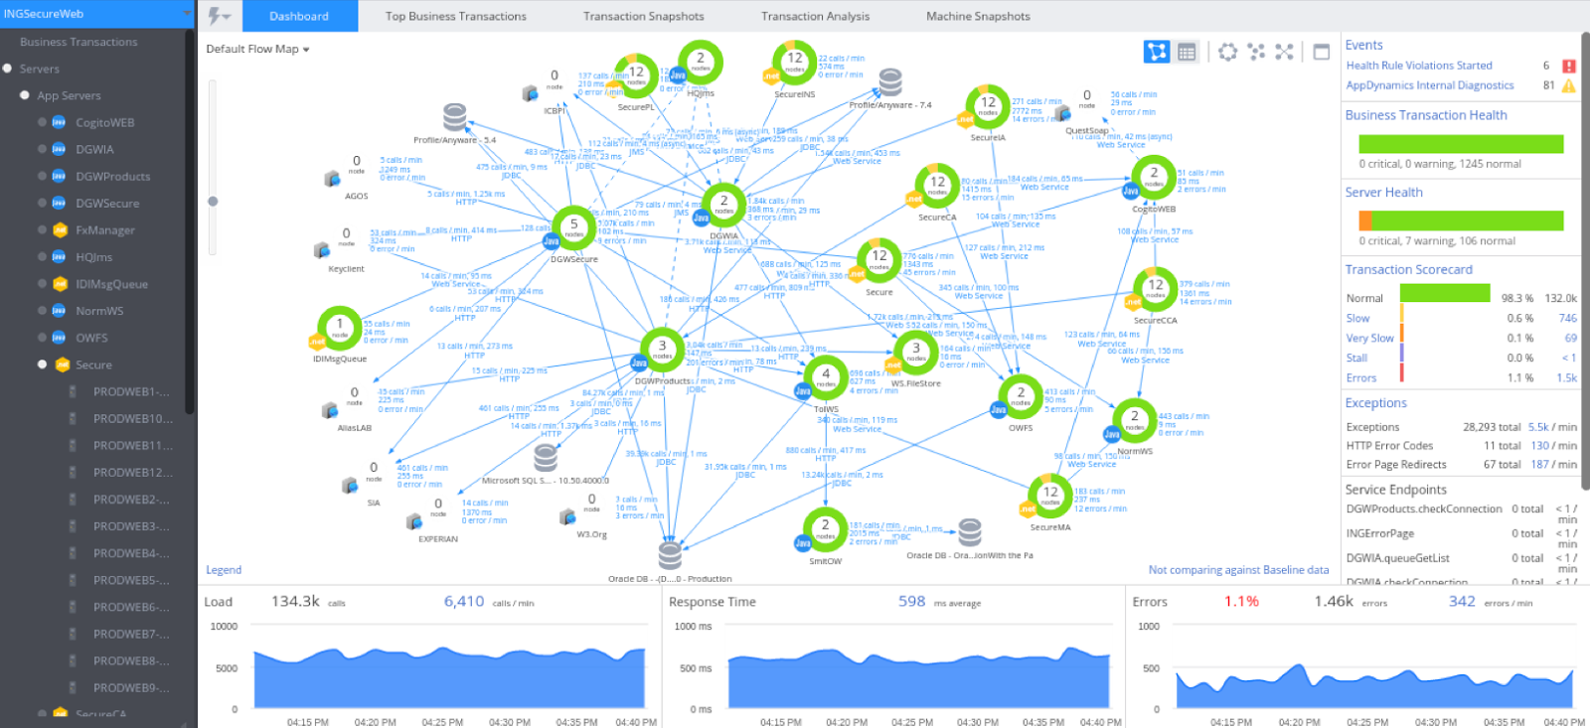
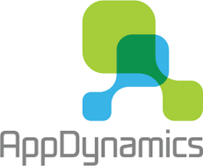
Highly observable
monitoring

Slide 64
Highly observable
Correlation ids
ID 5678
ID 5678
ID 5678
ID 5678

Slide 65
principles
Modularity
Autonomous
hide implementation details
Automation
Stateless
highly observable

Slide 66
Advantages

Slide 67
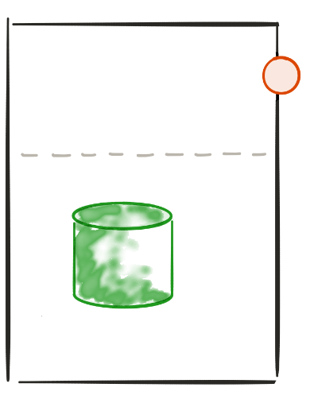
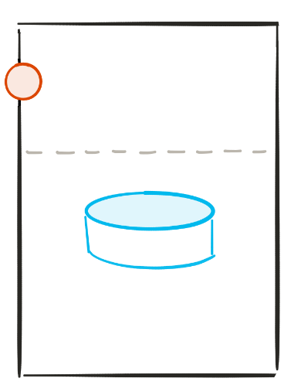


Polyglot architecture
The right technology for the job
reduce technical debt

Slide 68
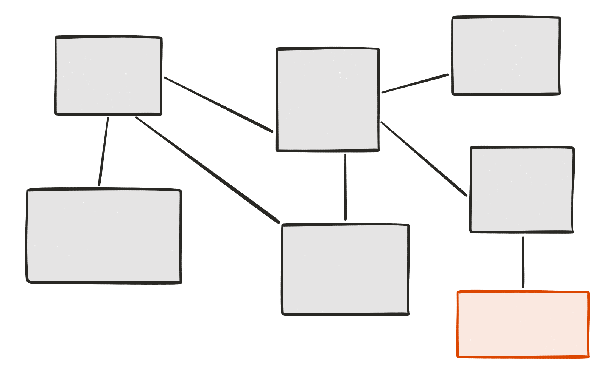
Evolutionary design
Remove
Add
Replace
Experimental microservice
Grow at “no” cost

Slide 69
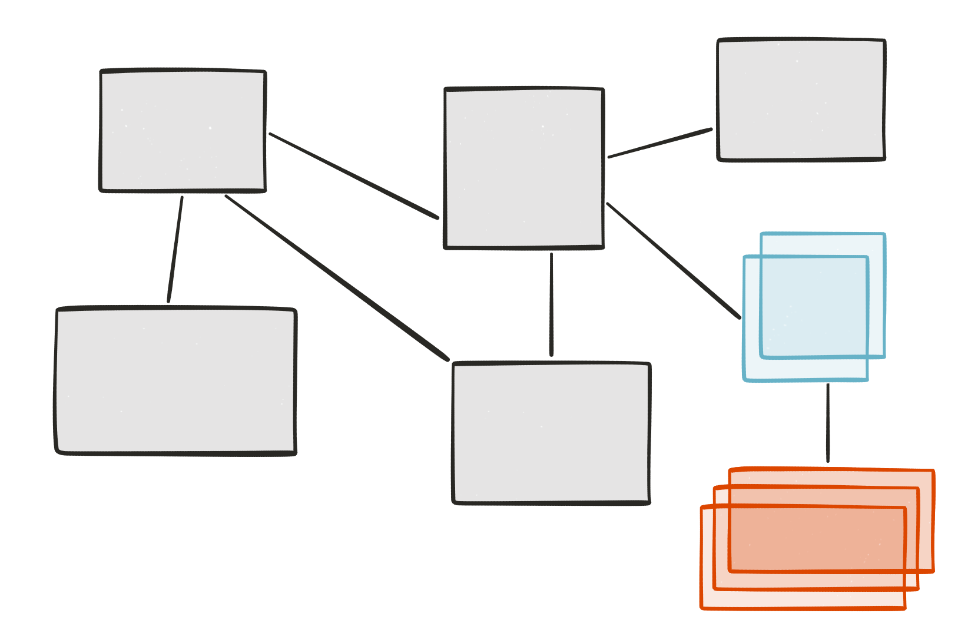
Selective scalability
Nb users > 500

Slide 70
Big vs small
Smaller code base
Simpler to develop / test / deploy / scale
Start faster
Easier for new developers

Slide 71
drawbacks

Slide 72
Distributed system
Consistency
Transaction
Request travelling
Slow (http)
Requires an ecosystem
Synchronous vs asynchronous
Integration tests
Conclusion:
The Microservices architecture is more complex
Than a monolith.
This the cost of growing and scaling easily

Slide 73
Microservices ecosystem

Slide 74

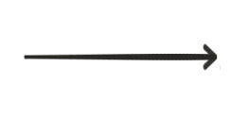

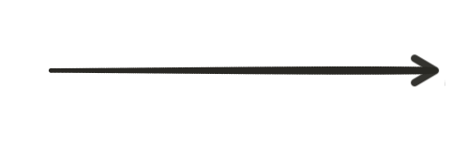

Load balancer
Load balancer

Slide 75

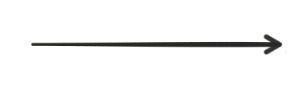
Load balancer (client side)
Load balancer

Slide 76
Service discovery
Service discovery
server
register
register

Slide 77
Service discovery
Service discovery
server
I want TO TALK TO THE PRODUCT SERVICE !
Here is the product service !

Slide 78
Service discovery (load balancing)
Service discovery
server
I want TO TALK TO THE PRODUCT SERVICE !
Here is one instance of product service !

Slide 79



Api Gateway
Browser UI
e.g. angular 2
Mobile app
API Gateway
e.G. (ZUUL)
Notes:
API gateway
Insulates the clients from how the application is partitioned into microservices
insulate the clients from the problem of determining the locations of service instances
Provides the optimal API for each client
Reduces the number of requests / roundtrips.
Backend for front end

Slide 80
This is not new!
The old new thing...
Principles
Modularity
Autonomous
hide implementation details
Automation
Stateless
highly observable
advantages
Polyglot architecture
Evolutionary design
Selective scalability
Big vs small
drawbacks
Distributed system
Synchronous vs asynchronous
Slow (http)
Requires an ecosystem
ecosystem
Load balancer
Service discovery
api gateway

